Slide 1
A Universal Turing Machine

Slide 2
A limitation of Turing Machines:
Turing Machines are “hardwired”
they execute
only one program
Real Computers are re-programmable

Slide 3
Solution:
Universal Turing Machine
Attributes:
Reprogrammable machine
Simulates any other Turing Machine

Slide 4

Universal Turing Machine
simulates any Turing Machine
Input of Universal Turing Machine:
Description of transitions of
Input string of

Slide 5
Tape 1
Three tapes
Description of
Universal
Turing
Machine
Tape 2
Tape Contents of
Tape 3
State of

Slide 6
Tape 1
Description of
We describe Turing machine
as a string of symbols:
We encode as a string of symbols

Slide 7








Alphabet Encoding
Symbols:
Encoding:

Slide 8






State Encoding
States:
Encoding:
Head Move Encoding
Move:
Encoding:

Slide 9
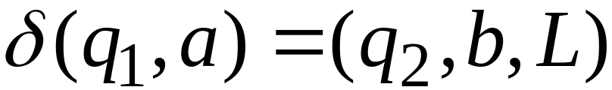
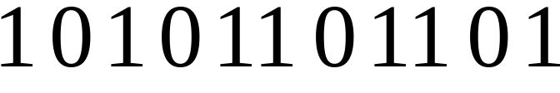
Transition Encoding
Transition:
Encoding:
separator

Slide 10
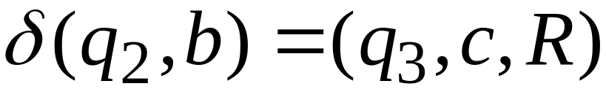

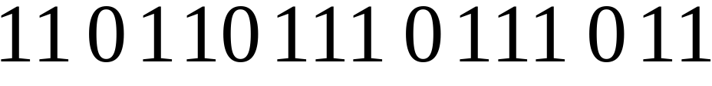
Turing Machine Encoding
Transitions:
Encoding:
separator

Slide 11
Tape 1 contents of Universal Turing Machine:
binary encoding
of the simulated machine
Tape 1

Slide 12
A Turing Machine is described
with a binary string of 0’s and 1’s
Therefore:
The set of Turing machines
forms a language:
each string of this language is
the binary encoding of a Turing Machine

Slide 13
Language of Turing Machines
L = { 010100101,
00100100101111,
111010011110010101,
…… }
(Turing Machine 1)
(Turing Machine 2)
……

Slide 14
Countable Sets

Slide 15
Infinite sets are either:
Countable
or
Uncountable

Slide 16
Countable set:
There is a one to one correspondence
of
elements of the set
to
Natural numbers (Positive Integers)
(every element of the set is mapped to a number
such that no two elements are mapped to same number)

Slide 17
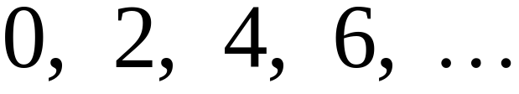
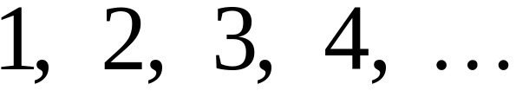


Example:
The set of even integers
is countable
Even integers:
(positive)
Correspondence:
Positive integers:
corresponds to

Slide 18
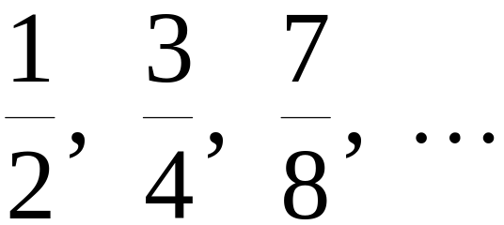
Example:
The set of rational numbers
is countable
Rational numbers:

Slide 19
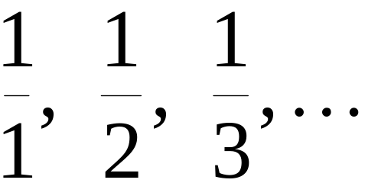
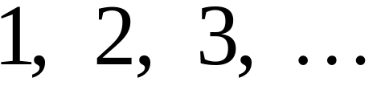
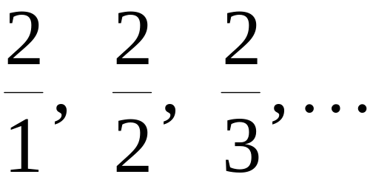
Naïve Approach
Nominator 1
Rational numbers:
Correspondence:
Positive integers:
Doesn’t work:
we will never count
numbers with nominator 2:

Slide 20










Better Approach

Slide 26
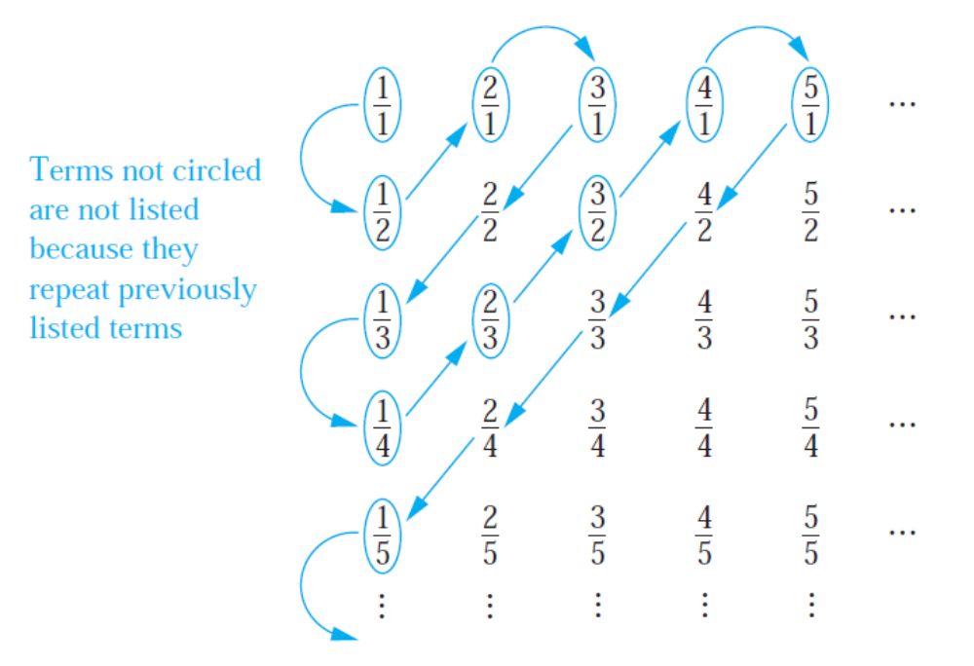

Slide 27
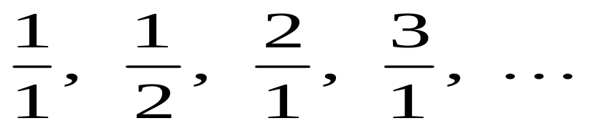
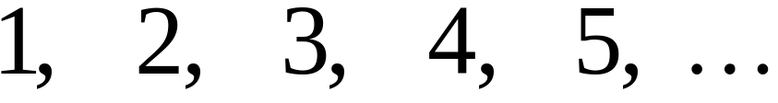
Rational Numbers:
Correspondence:
Positive Integers:

Slide 28
We proved:
the set of rational numbers is countable
by describing an enumeration procedure
(enumerator)
for the correspondence to natural numbers

Slide 29


Definition
Let be a set of strings (Language)
An enumerator for is a Turing Machine
that generates (prints on tape)
all the strings of one by one
and
each string is generated in finite time

Slide 30
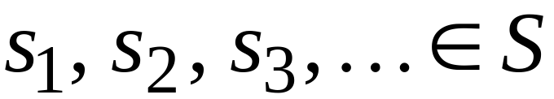
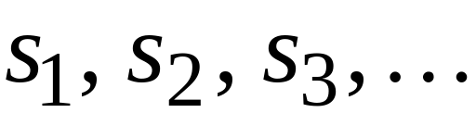

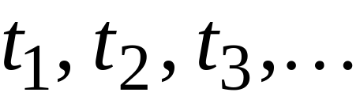
strings
Enumerator
Machine for
output
(on tape)
Finite time:

Slide 31







Enumerator Machine
Configuration
Time 0
prints
Time

Slide 32






prints
Time
prints
Time

Slide 33
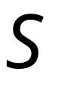
Observation:
If for a set there is an enumerator,
then the set is countable
The enumerator describes the
correspondence of to natural numbers

Slide 34
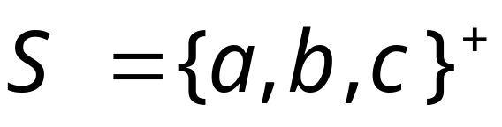
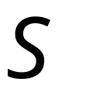
Example:
The set of strings
is countable
Approach:
We will describe an enumerator for

Slide 35






Naive enumerator:
Produce the strings in lexicographic order:
Doesn’t work:
strings starting with
will never be produced

Slide 36
Better procedure:
Proper Order
(Canonical Order)
1. Produce all strings of length 1
2. Produce all strings of length 2
3. Produce all strings of length 3
4. Produce all strings of length 4
..........

Slide 37

















length 1
Produce strings in
Proper Order:
length 2
length 3

Slide 38
Theorem:
The set of all Turing Machines
is countable
Proof:
Any Turing Machine can be encoded
with a binary string of 0’s and 1’s
Find an enumeration procedure
for the set of Turing Machine strings

Slide 39
Enumerator:
Repeat
1. Generate the next binary string
of 0’s and 1’s in proper order
2. Check if the string describes a
Turing Machine
if YES: print string on output tape
if NO: ignore string

Slide 40





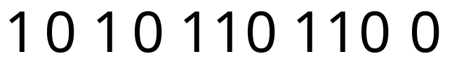

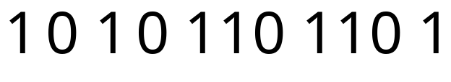
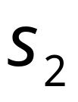
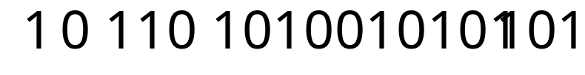
Binary strings
Turing Machines
End of Proof

Slide 41
Uncountable Sets

Slide 42
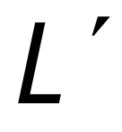
We will prove that there is a language
which is not accepted by any Turing machine
Technique:
Turing machines are countable
Languages are uncountable
(there are more languages than Turing Machines)

Slide 43
Definition:
A set is uncountable
if it is not countable
We will prove that there is a language
which is not accepted by any Turing machine

Slide 44
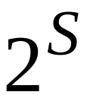
Theorem:
If is an infinite countable set, then
the powerset of is uncountable.
(the powerset is the set whose elements
are all possible sets made from the elements of )

Slide 45
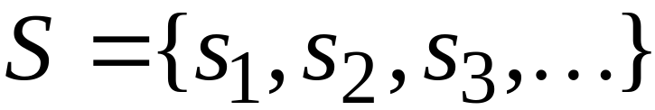
Proof:
Since is countable, we can write
Elements of

Slide 46
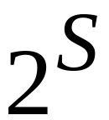

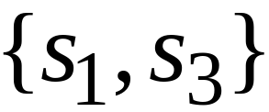
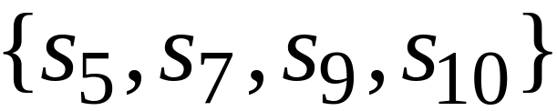
Elements of the powerset have the form:
……

Slide 47




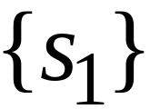

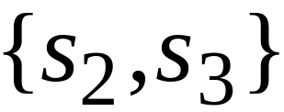
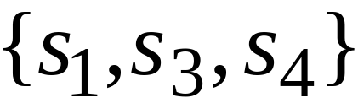
We encode each element of the powerset
with a binary string of 0’s and 1’s
Powerset
element
Binary encoding
(in arbitrary order)

Slide 48
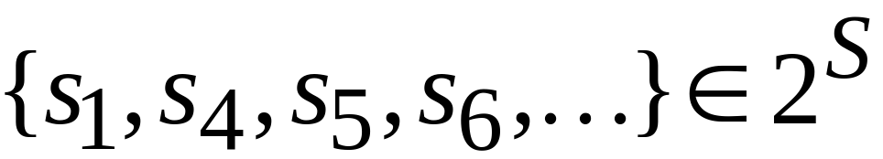
Observation:
Every infinite binary string corresponds
to an element of the powerset:
Example:
Corresponds to:

Slide 49
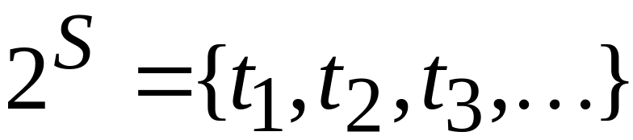
Let’s assume (for contradiction)
that the powerset is countable
Then: we can enumerate
the elements of the powerset

Slide 50




Powerset
element
suppose that this is the respective
Binary encoding

Slide 51
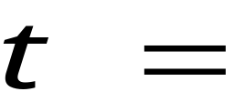
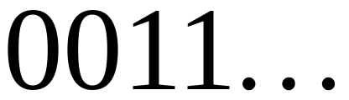
Take the binary string whose bits
are the complement of the diagonal
Binary string:
(birary complement of diagonal)

Slide 52
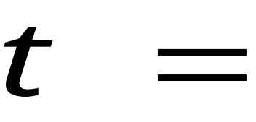
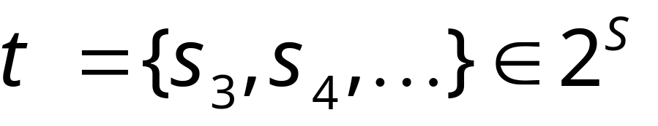
The binary string
corresponds
to an element of
the powerset :

Slide 53


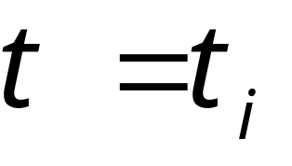
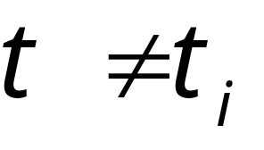
Thus, must be equal to some
However,
the i-th bit in the encoding of is
the complement of the bit of , thus:
i-th
Contradiction!!!

Slide 54
Since we have a contradiction:
The powerset of is uncountable
End of proof

Slide 55
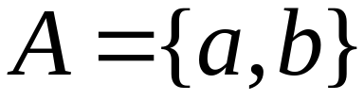
An Application: Languages
Consider Alphabet :
The set of all Strings:
infinite and countable
(we can enumerate the strings
in proper order)

Slide 56
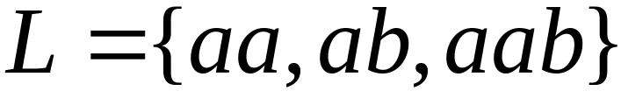
Consider Alphabet :
The set of all Strings:
infinite and countable
Any language is a subset of :

Slide 57
Consider Alphabet :
The set of all Strings:
infinite and countable
The powerset of contains all languages:
uncountable

Slide 58
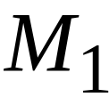
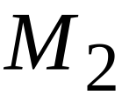
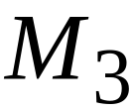



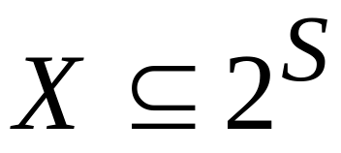
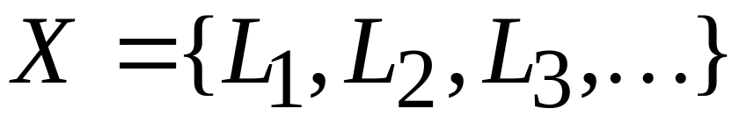

Consider Alphabet :
countable
Turing machines:
accepts
Languages accepted
By Turing Machines:
countable
Denote:
Note:
countable

Slide 59

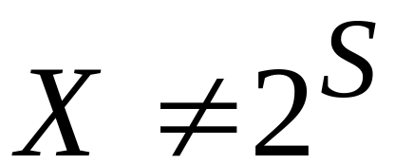
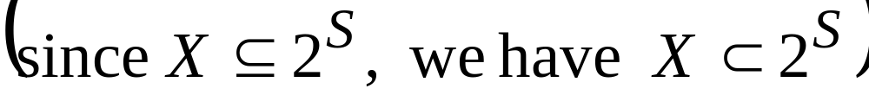
Languages accepted
by Turing machines:
countable
All possible languages:
uncountable
Therefore:

Slide 60

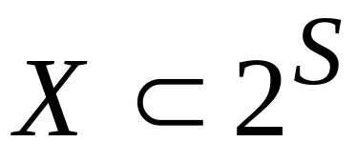


Conclusion:
There is a language not accepted
by any Turing Machine:
(Language cannot be described
by any algorithm)

Slide 61

Non Turing-Acceptable Languages
Turing-Acceptable
Languages

Slide 62
Note that:
is a multi-set (elements may repeat)
since a language may be accepted
by more than one Turing machine
However, if we remove the repeated elements,
the resulting set is again countable since every element
still corresponds to a positive integer

